Slide 1
Routing Fundamentals
Module 9

Slide 2
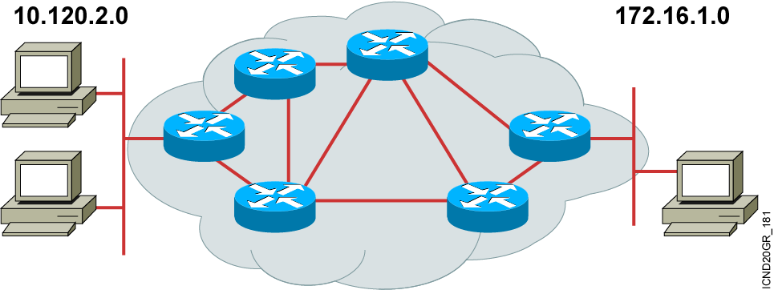
What Is Routing?
To route, a router needs to do the following:
Know the destination address
Identify the sources it can learn from
Discover possible routes
Select the best route
Maintain and verify routing information
Notes:
Slide 1 of 2
Purpose: This figure introduces students to routing. The router must accomplish the items listed in the figure for routing to occur.
Emphasize: Path determination occurs at Layer 3, the network layer. The path determination function enables a router to evaluate the available paths to a destination and to establish the best path.
Routing services use network topology information when evaluating network paths. This information can be configured by the network administrator (static routes) or collected through dynamic processes (routing protocols) running in the network.
Transition: How do you represent the path to the packet’s destination?

Slide 3
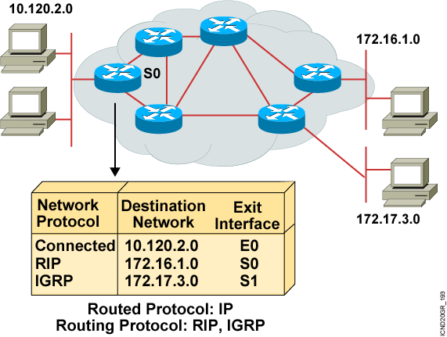
What Is a Routing Protocol?
Routing protocols are used between routers to determine paths and maintain routing tables.
Once the path is determined, a router can route a routed protocol.
Notes:
Purpose: This figure introduces students to routing protocols and compares routing protocols to routed protocols.
Emphasize: If network 10.120.2.0 wants to know about network 172.16.2.0, it must learn it from its S0 (or possibly S1) interface.
Note: The two routing protocols that will be taught in this course are RIP and IGRP. They are both distance vector routing protocols.

Slide 4
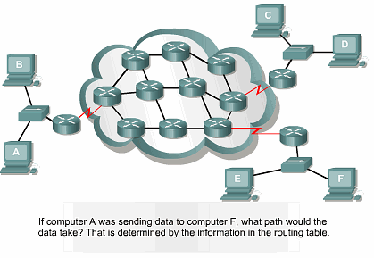
Path Determination

Slide 5
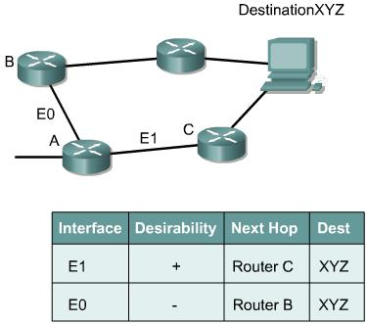
Path Determination

Slide 6
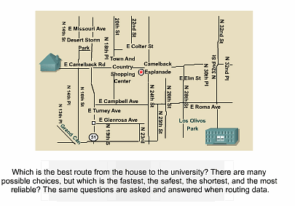
Path Determination

Slide 7
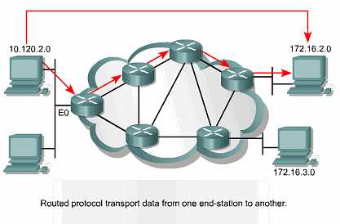
Routed Protocol

Slide 8
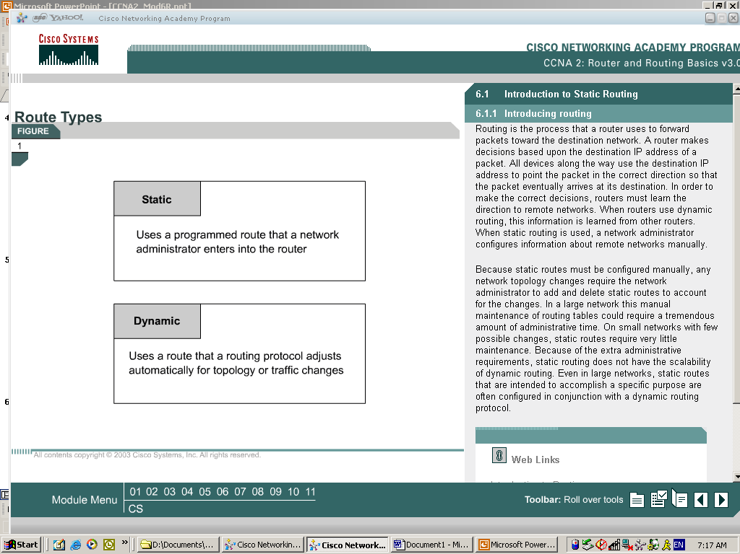
Route Types

Slide 9
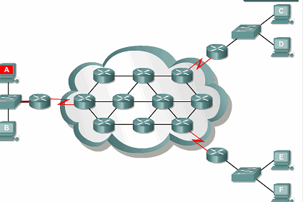
Routing

Slide 10
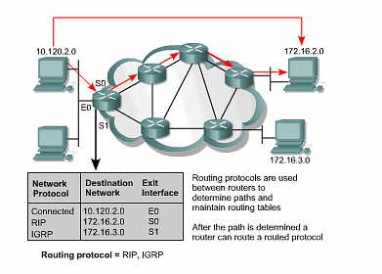
Routing Protocol

Slide 11
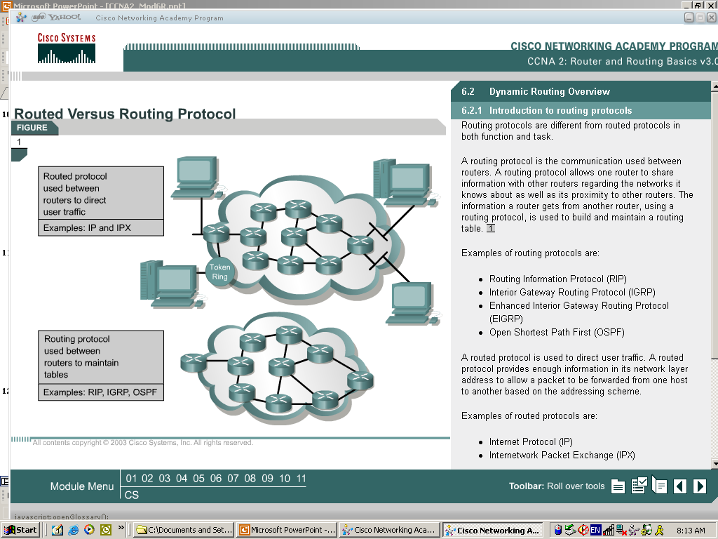
Routed Versus Routing Protocol

Slide 12
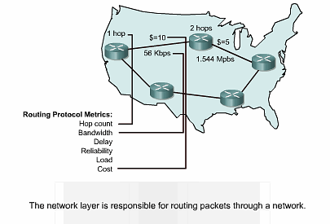
Routing Metrics

Slide 13
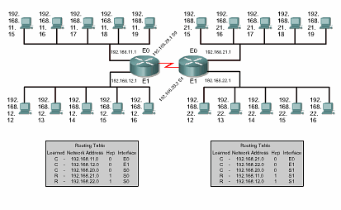
Routing Tables

Slide 14
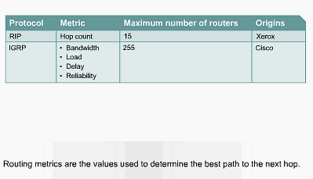
Routing Algorithms and Metrics

Slide 15
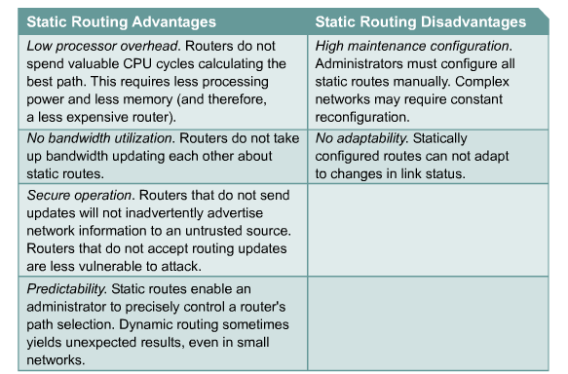
Static Routing

Slide 16

Using the ip route Commands

Slide 17
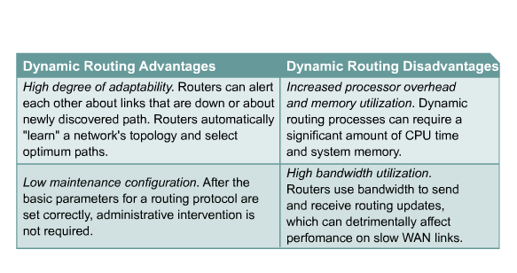
Dynamic Routing

Slide 18
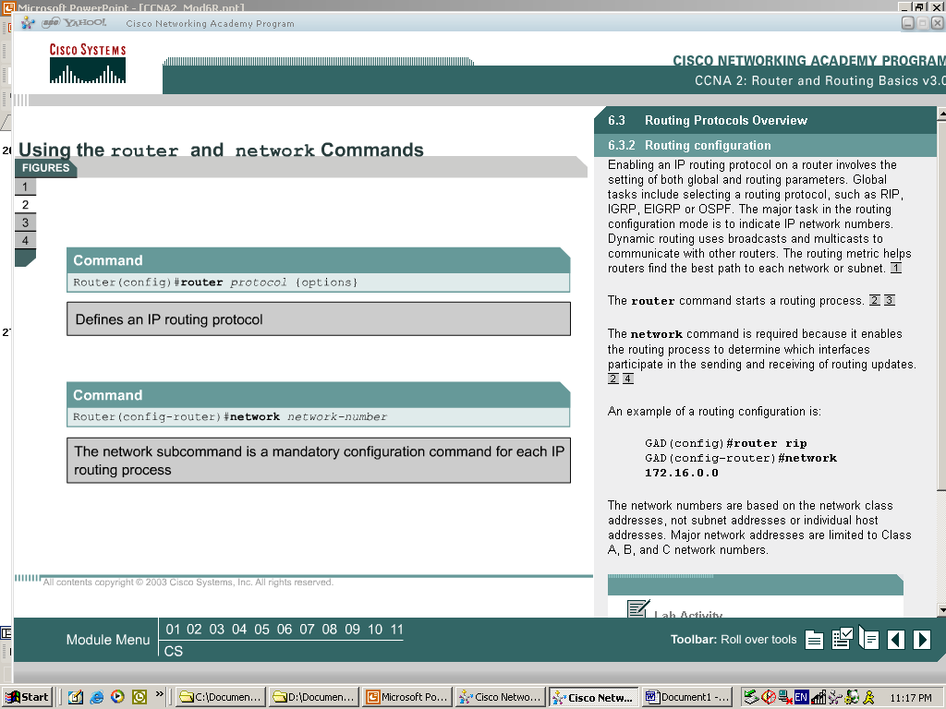
Using the router and network Commands

Slide 19
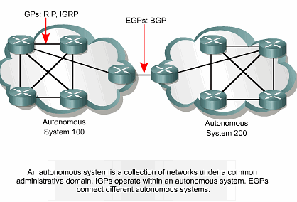
Interior and Exterior Gateway Protocols

Slide 20
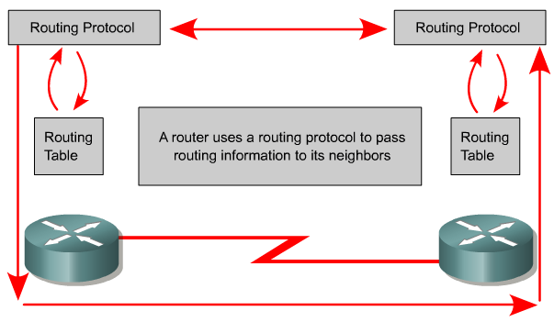
Dynamic Routing Operations

Slide 21
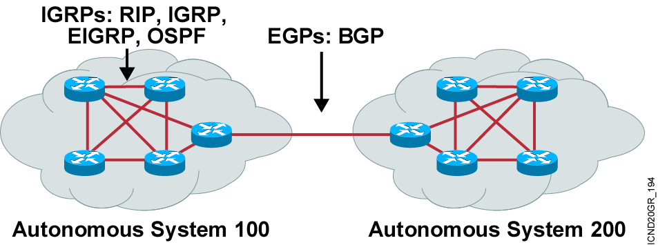
Autonomous Systems: Interior or Exterior Routing Protocols
An autonomous system is a collection of networks under a common administrative domain.
IGPs operate within an autonomous system.
EGPs connect different autonomous systems.
Notes:
Purpose: This figure discusses autonomous systems, IGPs and EGPs.
Emphasize: Introduce the interior/exterior distinctions for routing protocols, as follows:
Interior routing protocols are used within a single autonomous system
Exterior routing protocols are used to communicate between autonomous systems
The design criteria for an interior routing protocol require it to find the best path through the network. In other words, the metric and how that metric is used is the most important element in an interior routing protocol.
Exterior protocols are used to exchange routing information between networks that do not share a common administration. IP exterior gateway protocols require the following three sets of information before routing can begin:
A list of neighbor (or peer) routers or access servers with which to exchange routing information
A list of networks to advertise as directly reachable
The autonomous system number of the local router

Slide 22
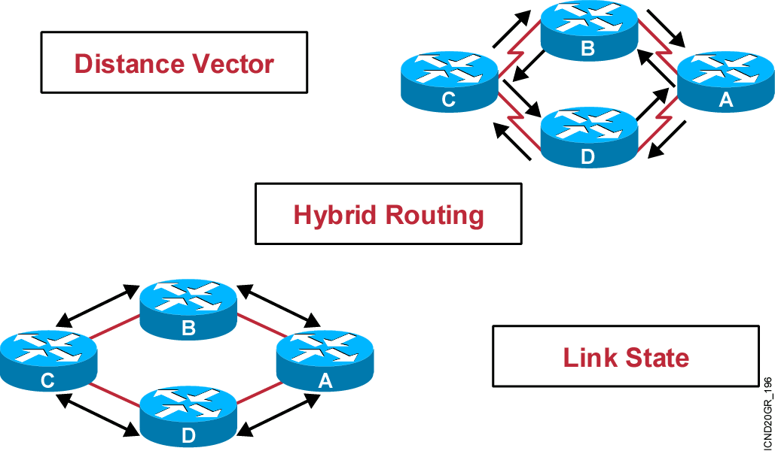
Classes of Routing Protocols
Notes:
Purpose: This figure introduces the three classes of routing protocols.
Emphasize: There is no single best routing protocol.
Note: Distance vector routing protocol operation is covered in detail later in this course. Link state and hybrid are only briefly explained after the distance vector discussion. Refer students to the ACRC to learn more about link-state and hybrid routing protocols.

Slide 23
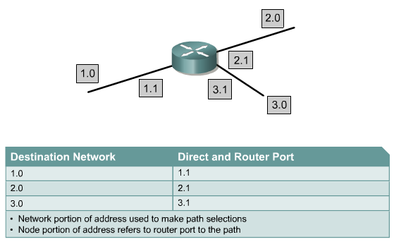
Routing with Network Addressing

Slide 24
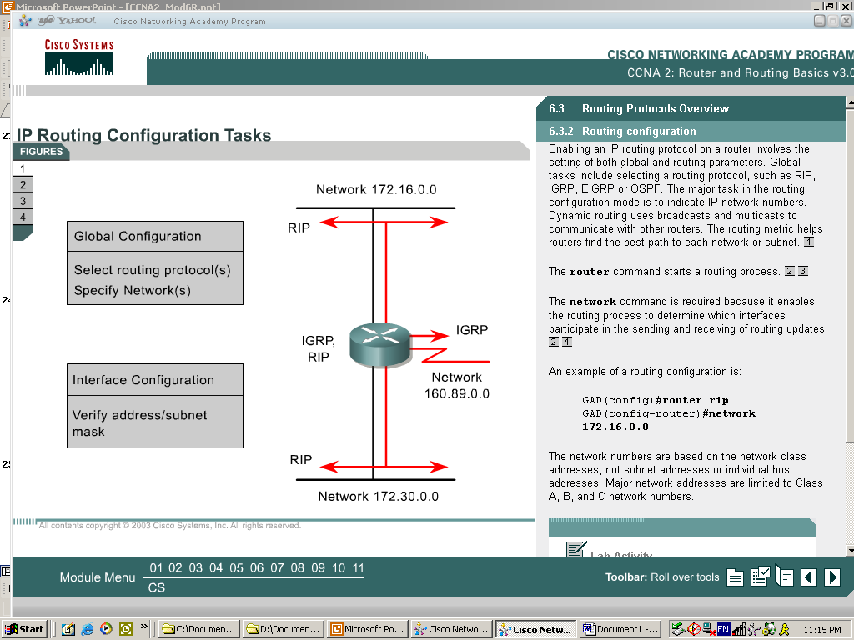
IP Routing Configuration Tasks

